Slide 1

Wildfire Prediction

Slide 2
INTRODUCTION
Importance of Predicting Wildfires:
Global Phenomenon: Wildfires occur year-round, influencing global ecological balance, vegetation, atmospheric composition, infrastructure, and human safety.
Extensive Impact: Annually, about 420 million hectares burn worldwide, affecting ecosystems and human activities on regional and global scales.
Climate Change Effects: Increasing temperatures are making wildfires more frequent and severe, posing greater risks to populations and environments.
Economic Significance: Billions of dollars are spent annually on wildfire mitigation and prediction, highlighting the need for effective forecasting.
Complexity in Prediction: Wildfire prediction is challenging due to the interplay of climate, vegetation, and human activities, as well as the unpredictable nature of fire-driving factors.
Technological Advances: Advances in machine learning and deep learning are enhancing prediction accuracy, supporting better emergency response, ecosystem management, and land use planning.
Notes:
In recent years, we have witnessed a significant increase in the number natural disasters, driven largely by climate change. Events such as wildfires, hurricanes, floods, and droughts are occurring more frequently and with greater severity, causing extensive economic damage and loss of life.
One such natural disaster with increased occurrences is Wildfires. In 2023, severe wildfires in British Columbia and Alberta burned over 17 million hectares of land leading to mass evacuations and significant air quality issues across North America. Similarly, in 2024, wildfires in Australia’s New South Wales and Queensland destroyed land, homes, and prompted emergency declarations.
These events underscore the urgent need for improved prediction and preparedness strategies to mitigate their impacts on human life, nature and ecology as a whole. This is why our group decided to work on developing wildfire prediction models. Our aim is to leverage algorithms and deep learning techniques to enhance the accuracy and timeliness of wildfire forecasts.

Slide 3
INTRODUCTION
Complexity of Prediction:
Modeling Challenges: Non-linear interactions between weather, vegetation, and human activities make modeling difficult.
Deep Learning: Used to learn complex spatiotemporal interactions influencing wildfires.
Short-term Predictions: Temporal context often sufficient for daily predictions.
Long-term Predictions: Few studies on subseasonal to seasonal scales, using spatiotemporal data.

Slide 4
DATA CUBE
FEATURE | VALUE
Spatial Coverage | Global
Temporal Coverage | 2001 to 2021
Spatial Resolution | 25 km x 25 km
Temporal Resolution | 8 days
Number of Variables | 54
Notes:
The SeasFire Cube is a scientific datacube for seasonal fire forecasting around the globe.
Funded by the European Space Agency (ESA).
SEASfire data cube, spatial-temporal data. The spatial component: information about the geographical location of wildfires. temporal component: involves the timing and duration of wildfire events. It contains 21 years of data (2001-2021) in an 8-days time resolution and 0.25 degrees grid resolution.
It has a diverse range of seasonal fire drivers: expands from atmospheric and climatological ones to vegetation variables, socioeconomic and target variables related to wildfires such as burned areas, fire radiative power, and wildfire-related CO2 emissions.

Slide 5
DATA
VARIABLES
Fullname | Variable name
Mean sea level pressure | mslp
Total precipitation | tp
Vapor Pressure Deficit | vpd
Sea surface temperature | sst
Temperature at 2 meters - Mean | t2m_mean
Surface solar radiation downwards | ssrd
Volumetric soil water level 1 | swvl1
Land surface temperature at day | lst_day
Normalized Difference Vegetation Index | ndvi
Population density | pop_dens
Latitude (sin/cos) | cube coordinates
Longitude (sin/cos) | cube coordinates
Target | Variable name
Burned Areas (as binary) | gwis_ba
Notes:
We utilized 10 different variables (based on their relevance and usage in burned area prediction tasks from existing literature) In addition and when needed, we also used simple positional encodings by augmenting the feature vector with the actual cube coordinates, i.e. sin/cos of latitude and longitude.

Slide 6
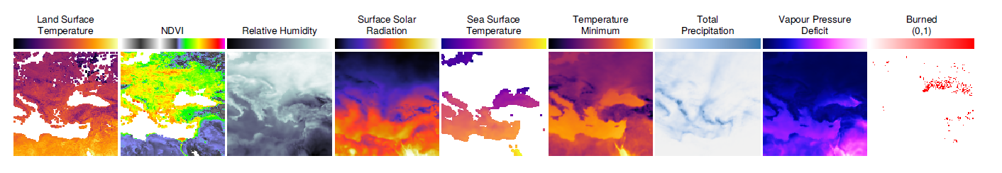
DATA VARIABLES
Selection of Predictive Variables: Based on their relevance and usage in burned area prediction tasks from existing literature.
Variable Utilization: Utilized 10 different variables for predicting fire occurrence over various time horizons
Positional Encoding: Enhanced feature vectors with positional encodings (sin/cos of latitude and longitude) to incorporate cube coordinates when needed.
Standardization: Standardized all variables, except cube coordinates, before use to ensure consistency in data processing.
Photo credit: @bruce.digital
Notes:
While leveraging the same dataset, we expanded upon initial research findings to develop and validate our own methodology for wildfire prediction models.
Our complexity lies in our objective to compare and evaluate multiple models and algorithms, aiming to identify the most effective predictor of wildfires.

Slide 7
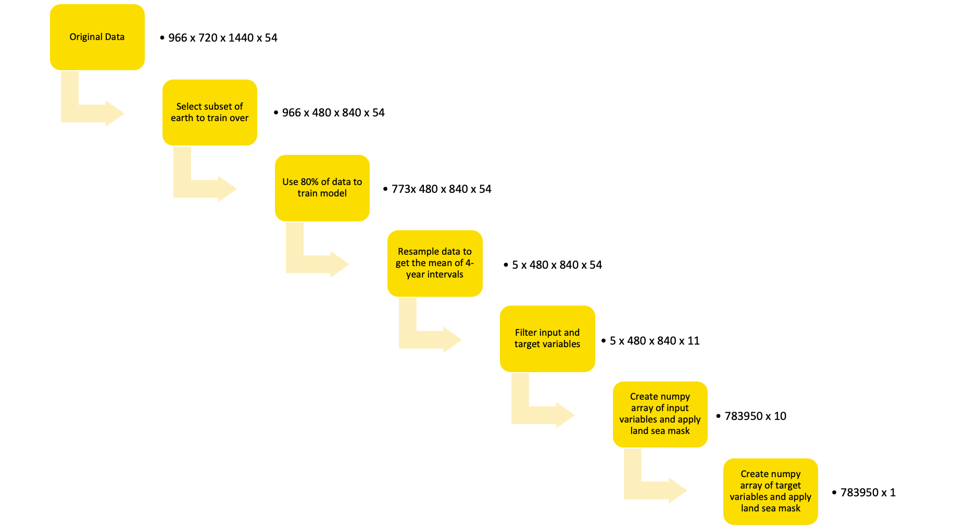
Data Pre-Processing
Notes:
To optimize the training time of our models, we used several data processing techniques for reducing our input data dimensions.
We reduced the surface area that was trained over (trained only for the eastern hemisphere since there was more wildfire data available in that region)
We trained on the first 16 years of data not the full 21 (80% of data)
we resampled our data to compute the mean values over 4-year intervals
we only trained on land values by using a land/sea mask (reducing 40% of irrelevant sea data)
removed any unnecessary features/variables

Slide 8
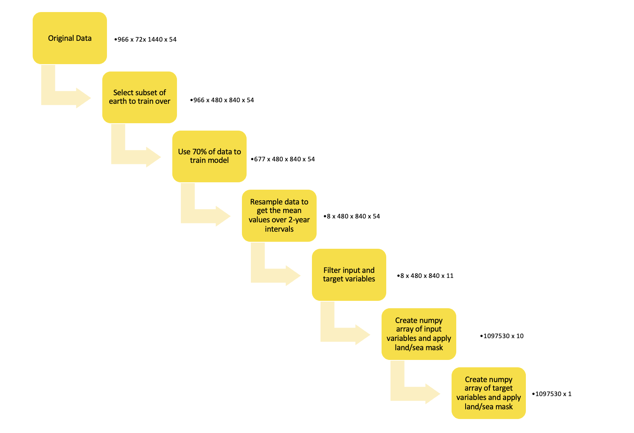
Data Pre-Processing
Notes:
To optimize the training time of our models, we used several data processing techniques for reducing our input data dimensions.
We reduced the surface area that was trained over (trained only for the eastern hemisphere since there was more wildfire data available in that region)
We trained on the first 16 years of data not the full 21 (80% of data)
we resampled our data to compute the mean values over 4-year intervals
we only trained on land values by using a land/sea mask (reducing 40% of irrelevant sea data)
removed any unnecessary features/variables

Slide 9
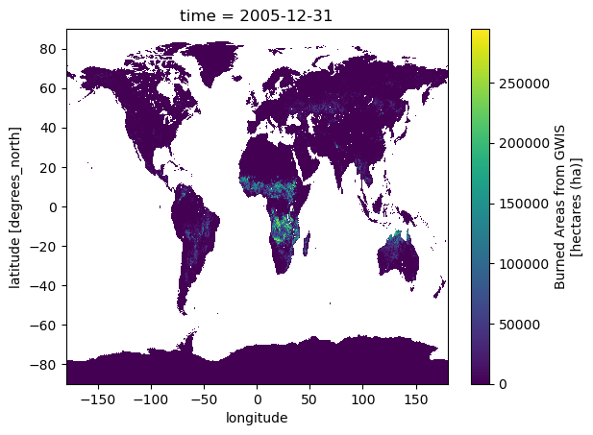
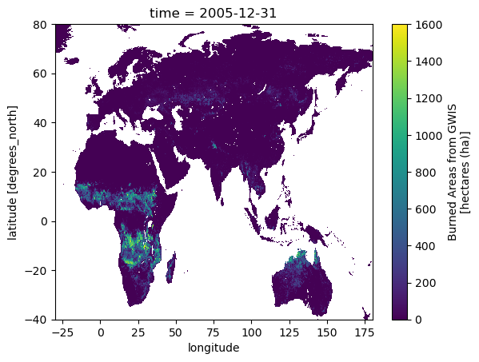
Data Reduction

Slide 10
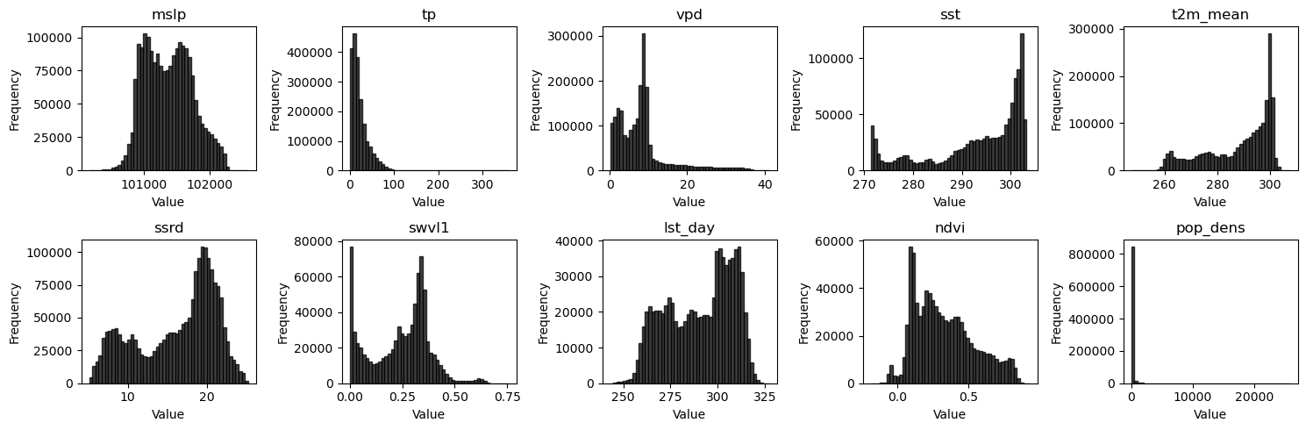
Input Features
Notes:
There were no outliers observed so no further data cleaning was required

Slide 11
METHODOLOGY
Notes:
Next we used our data to train four models

Slide 12
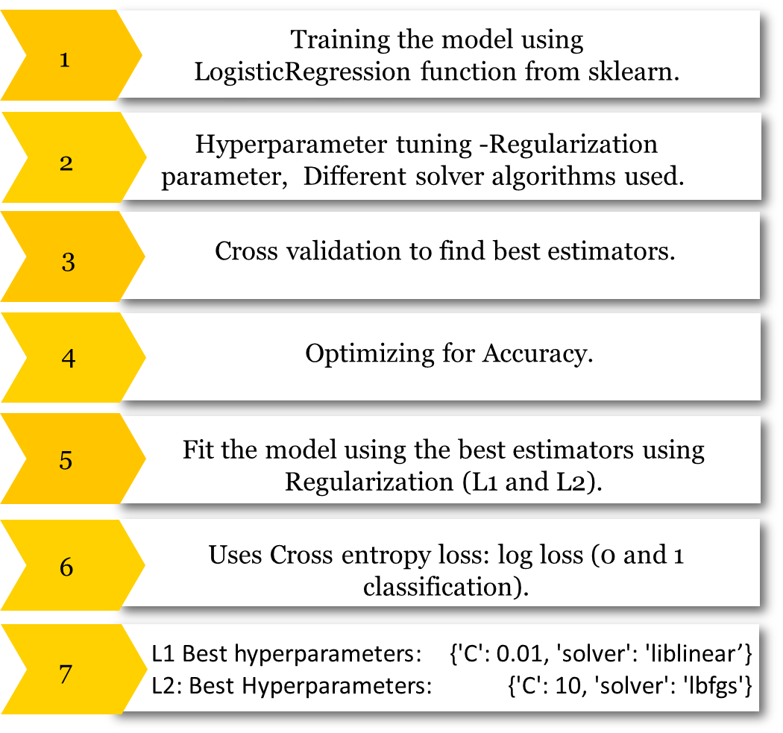
LOGISTIC
REGRESSION
Notes:
We trained two logistic regression models using L1 and L2 regularization. We implemented the models using Sklearn. We tuned the regularization strength (1/C) and the solver (Algorithm to use in the optimization problem) during training by using 2-fold CV.
liblinear - coordinate descent Coordinate descent is based on the idea that the minimization of a multivariable function 𝐹(𝑥) can be achieved by minimizing it along one direction at a time, i.e., solving univariate (or at least much simpler) optimization problems in a loop.
lbfgs - Limited-memory Broyden–Fletcher–Goldfarb–Shanno algorithm L-BFGS uses an estimate of the inverse Hessian matrix to steer its search through variable space, but where BFGS stores a dense 𝑛×𝑛 approximation to the inverse Hessian (n being the number of variables in the problem), L-BFGS stores only a few vectors that represent the approximation implicitly. Due to its resulting linear memory requirement, the L-BFGS method is particularly well suited for optimization problems with many variables

Slide 13
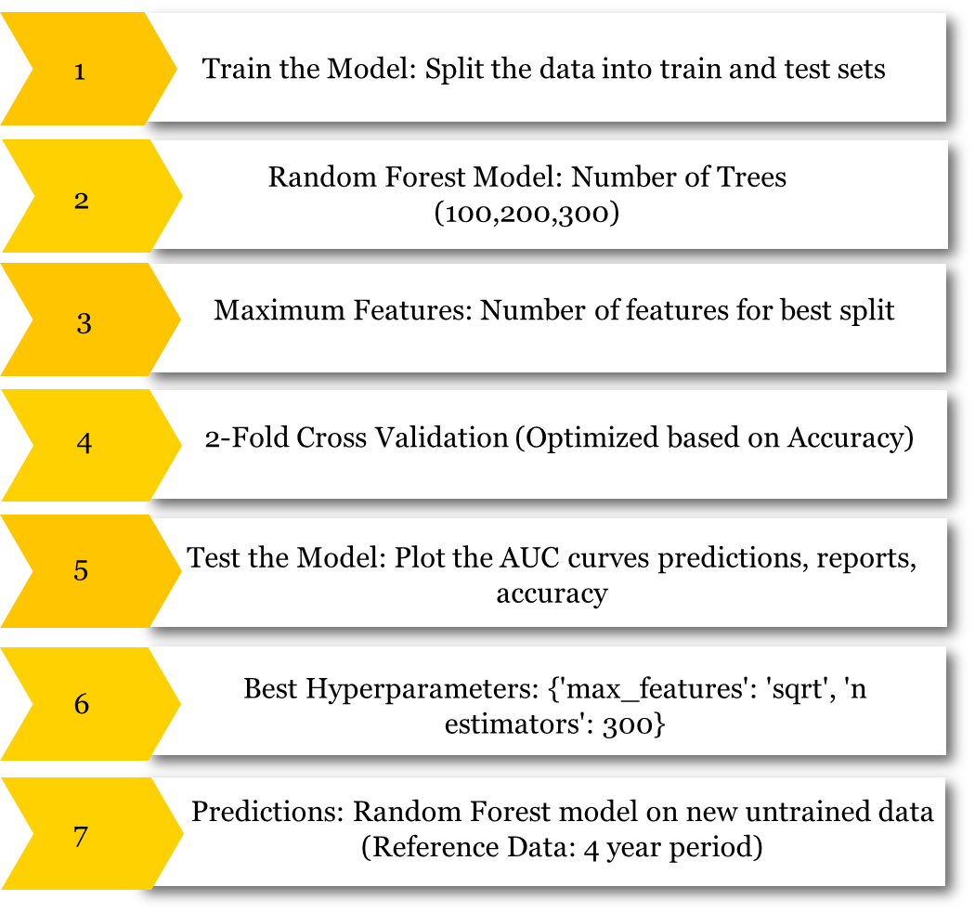
RANDOM FOREST
Notes:
Next we trained a random forest model using Sklearn and tuned the forest size and the number of features to consider when looking for the best split during training by using 2-fold CV.

Slide 14
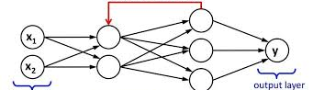
Long Short Term Memory (LSTM)
Parameters
Input features 10
Output (binary classification)
Activation function (Relu)
Dropout rate = 0.5
learning rate = 0.001
10 features
2 LSTM layers , one fully connected layer. Relu activation used
output 1 or 0 after applying sigmoid

Slide 15
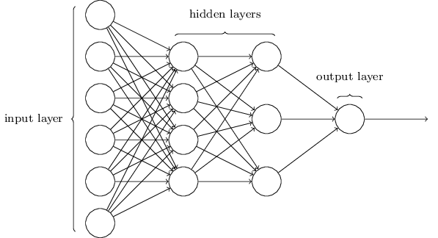
Feed Forward Neural Network
Parameters
SMOTE
Input features 10
Output (binary classification)
Activation function (Relu)
Dropout rate = 0.2
learning rate = 0.001
output 1 or 0 after applying sigmoid
5 hidden layers with 350, 300, 250, 200, 150 neurons and relu activation
10 features

Slide 16
RESULTS

Slide 17
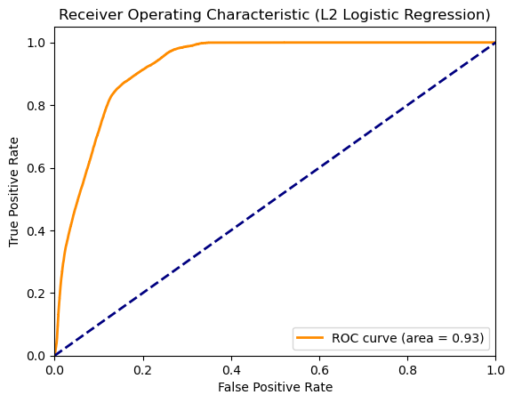
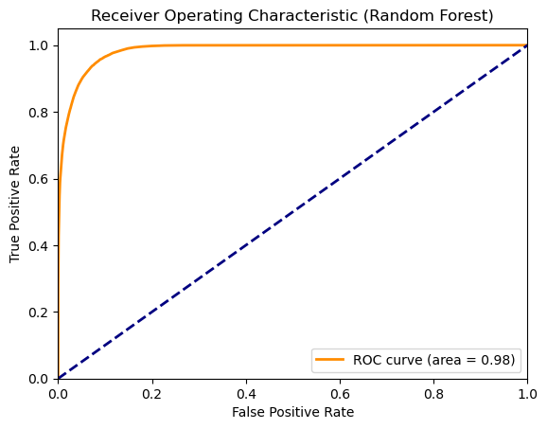

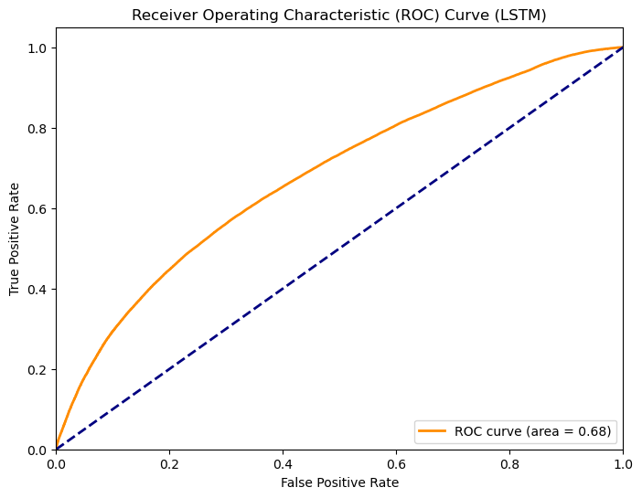
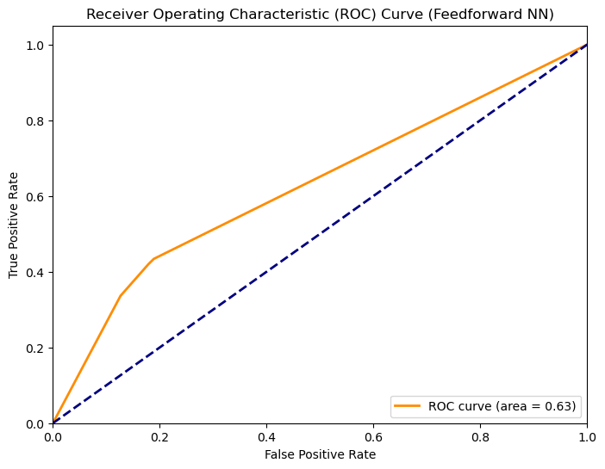
ROC Curves

Slide 18
RESULTS
 | Logistic Regression (L1) | Logistic Regression (L2) | Random Forest | LSTM | FeedForward NN
Accuracy (overall) | 91.29% | 91.08% | 96.03% | 12.56% | 69%
Precision (1’s only) | 68% | 67% | 86% | 12.56% | 73%
Recall (1’s only) | 43% | 41% | 77% | 100% | 61%
F1-score (1’s only) | 53% | 51% | 81% | 22% | 67%

Slide 19
Regression Tables and Feature Importance
Input Feature | L2 Regression (Log Odds of Burned Area Probability) | L1 Regression (Log Odds of Burned Area Probability) | Random Forest (Feature Importance)
mslp | -0.00029734 | -0.0000217445925 | 0.06079535
tp | -0.01503 | -0.0402609814 | 0.08380166
vpd | -0.14668816 | 0.0128955127 | 0.10601796
sst | -0.01183601 | -0.00896848225 | 0.02834566
t2m_mean | 0.09202544 | -0.005.33646279 | 0.07468282
ssrd | 0.03344947 | 0.133262267 | 0.10024988
swvl1 | 0.23110262 | 4.77915137 | 0.14019945
lst_day | 0.01432592 | 0.00311183035 | 0.10967107
ndvi | 0.27069832 | 5.08277994 | 0.2060267
pop_dens | -0.00096867 | -0.000392050790 | 0.09020944

Slide 20
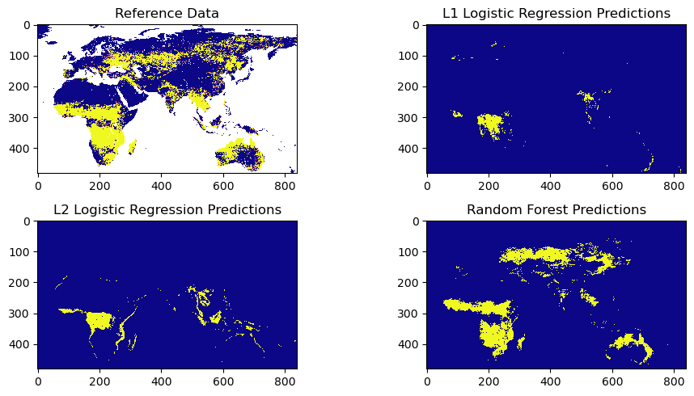
Predictions

